Slide 1
Applications of stack

Slide 2
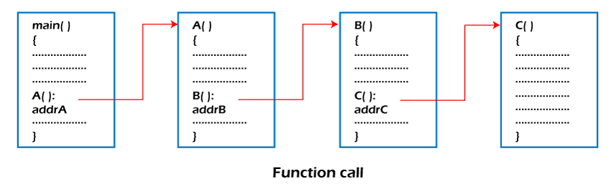
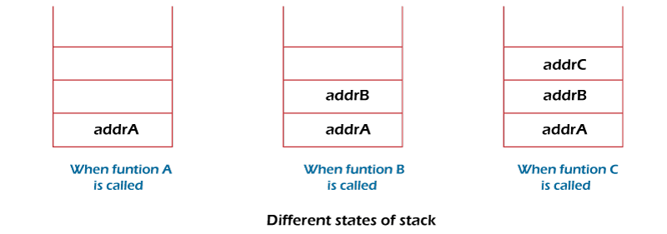
Application of Stack in Data Structure
Function calls and recursion: When a function is called, the current state of the program is pushed onto the stack. When the function returns, the state is popped from the stack to resume the previous function’s execution.

Slide 3
Expression evaluation and conversion: Stack data structure is used to evaluate expressions in infix, postfix, and prefix notations. Operators and operands are pushed onto the stack, and operations are performed based on the stack’s top elements.
Conversion from
infix to prefix
infix to postfix
prefix to infix

Slide 4
Convert infix to postfix
Scan all the symbols one by one from left to right in the given Infix Expression.
If the reading symbol is an operand, then immediately append it to the Postfix Expression.
If the reading symbol is left parenthesis ‘( ‘, then Push it onto the Stack.
If the reading symbol is right parenthesis ‘)’, then Pop all the contents of the stack until the respective left parenthesis is popped and append each popped symbol to Postfix Expression.
If the reading symbol is an operator (+, –, *, /), then Push it onto the Stack. However, first, pop the operators which are already on the stack that have higher or equal precedence than the current operator and append them to the postfix. If an open parenthesis is there on top of the stack then push the operator into the stack.
If the input is over, pop all the remaining symbols from the stack and append them to the postfix.

Slide 5
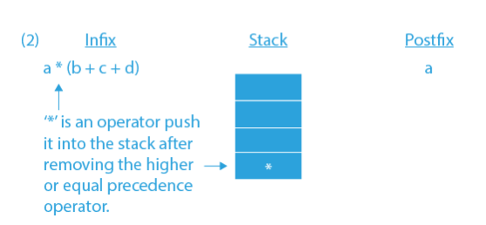
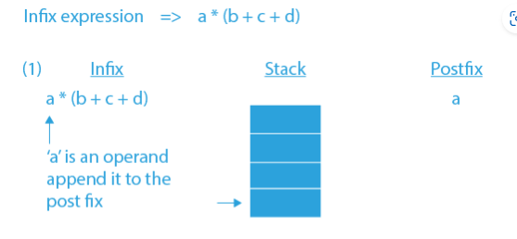
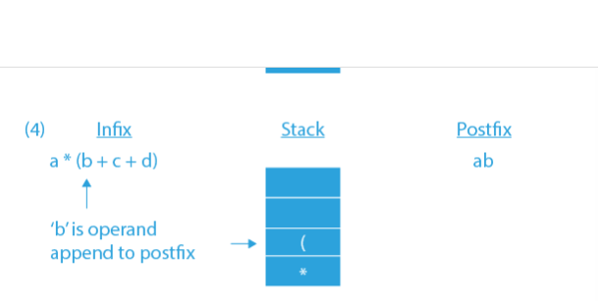
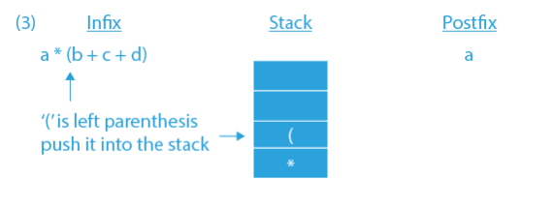

Slide 6
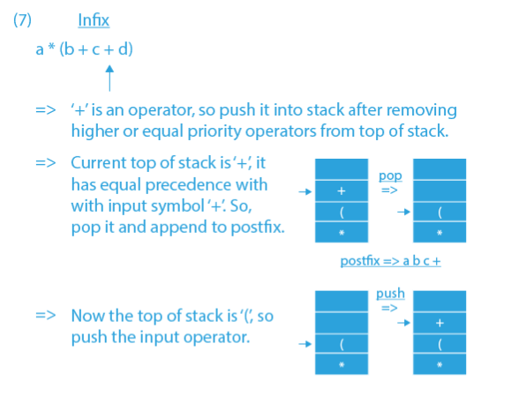
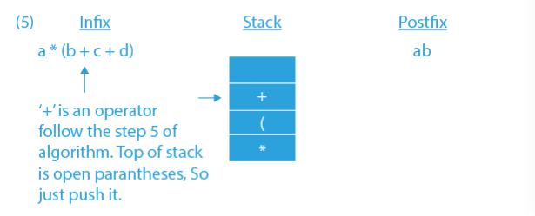
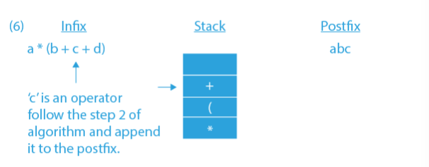

Slide 7
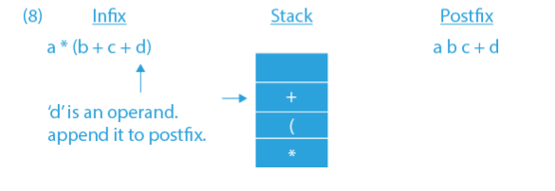
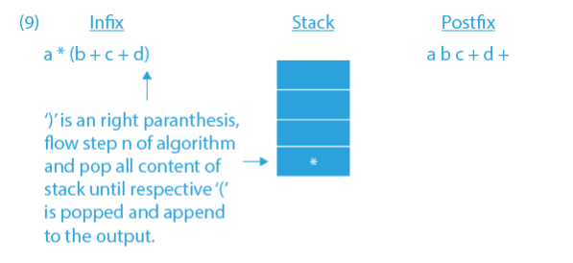
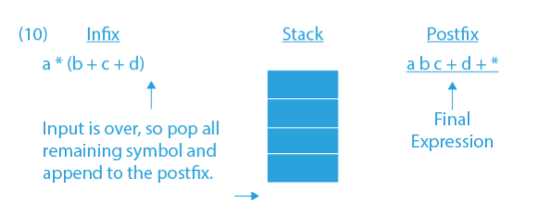

Slide 8
Evaluation of postfix expression
Create a stack that holds integer type data to store the operands of the given postfix expression. Let it be st.
Iterate over the string from left to right and do the following -
If the current element is an operand, push it into the stack.
Otherwise, if the current element is an operator (say /)do the following -
Pop an element from st, let it be op1.
Pop another element from st, let it be op2.
Computer the result of op2 / op1, and push it into the stack. Note the order i.e. op2 / op1 should not be changed otherwise it will affect the final result in some cases.
At last, st will consist of a single element i.e. the result after evaluating the postfix expression.

Slide 9
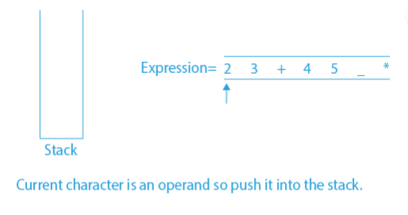
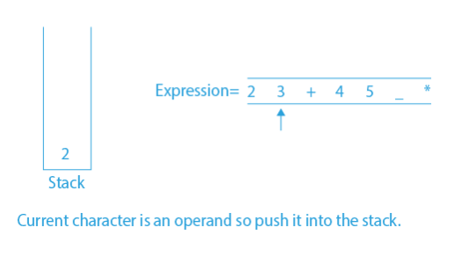
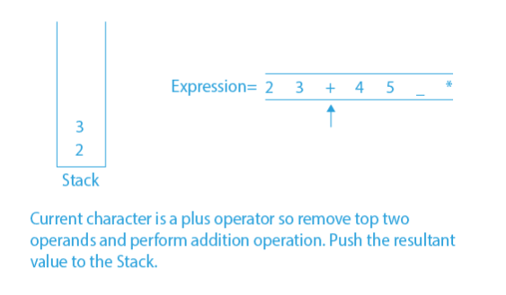
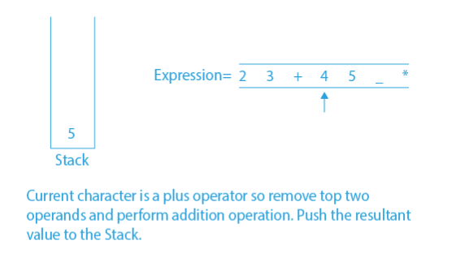

Slide 10
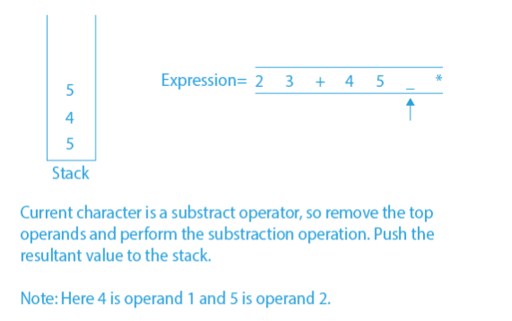
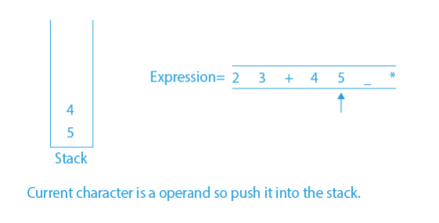
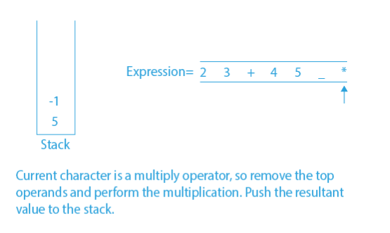
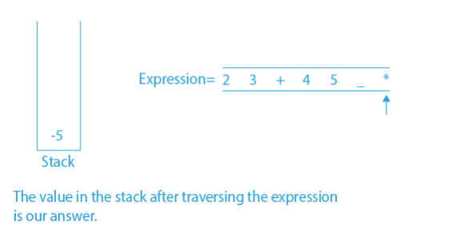

Slide 11
Check Balanced Parentheses
Initialize an empty stack.
Iterate i from 0 to length(expression).
Store the current character in a variable ‘ch’.
If stack is empty: Push ‘ch’ to the stack
Else if current character is a closing bracket and of the top of the stack contains an opening bracket of the same type then remove the top of the stack: Else, push ‘ch’ to the stack
If the stack is empty, return true, else false.

Slide 12
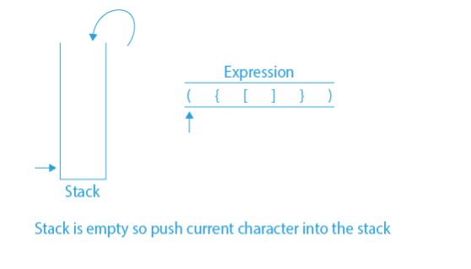
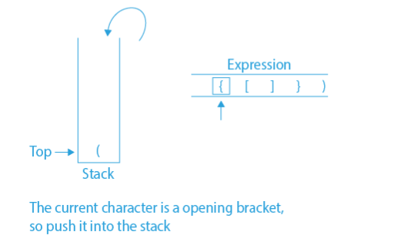
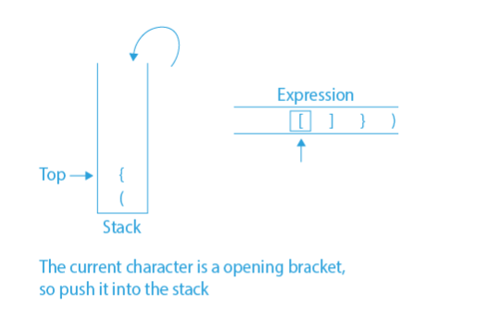
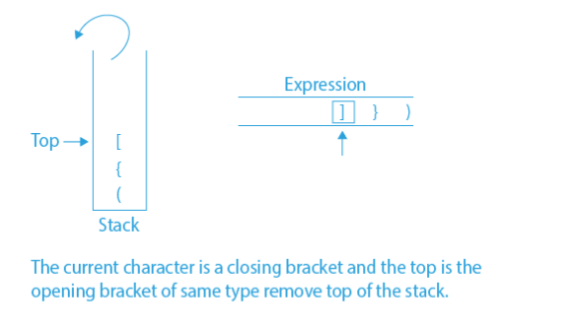

Slide 13
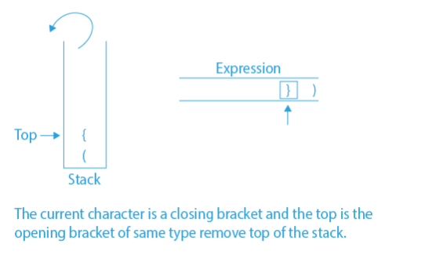
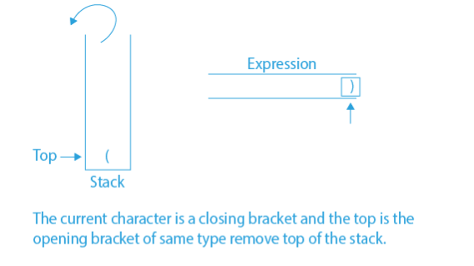
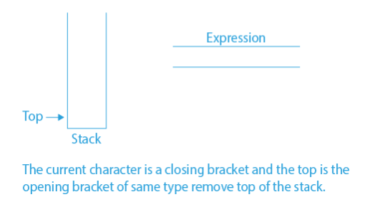

Slide 14
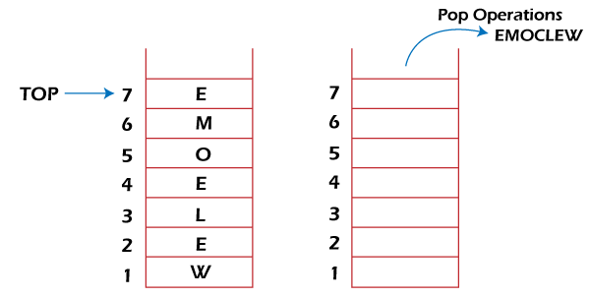
Reverse a String
A Stack can be used to reverse the characters of a string. This can be achieved by simply pushing one by one each character onto the Stack, which later can be popped from the Stack one by one. Because of the last in first out property of the Stack, the first character of the Stack is on the bottom of the Stack and the last character of the String is on the Top of the Stack and after performing the pop operation in the Stack, the Stack returns the String in Reverse order.

Slide 15
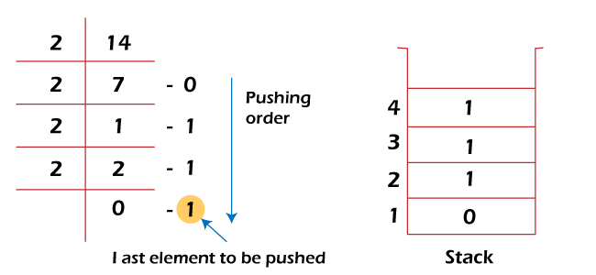
Converting Decimal to Binary:
Although decimal numbers are used in most business applications, some scientific and technical applications require numbers in either binary, octal, or hexadecimal. A stack can be used to convert a number from decimal to binary/octal/hexadecimal form. For converting any decimal number to a binary number, we repeatedly divide the decimal number by two and push the remainder of each division onto the Stack until the number is reduced to 0. Then we pop the whole Stack and the result obtained is the binary equivalent of the given decimal number.

Slide 16
Undo/Redo operations: The undo-redo feature in various applications uses stacks to keep track of the previous actions. Each time an action is performed, it is pushed onto the stack. To undo the action, the top element of the stack is popped, and the reverse operation is performed.
Browser history: Web browsers use stacks to keep track of the web pages you visit. Each time you visit a new page, the URL is pushed onto the stack, and when you hit the back button, the previous URL is popped from the stack.
Backtracking Algorithms: The backtracking algorithm uses stacks to keep track of the states of the problem-solving process. The current state is pushed onto the stack, and when the algorithm backtracks, the previous state is popped from the stack

Slide 17
Application of Stack in Real Life
Women’s Bangles: Women wear a bangle one by one and to pull the first one they have to first pull out the last one.
Books and Clothes: Piled on top of each other is a great example of the stack.
Floors in a Building: If a person is living on the top floor and wants to go outside, he/she first needs to land on the ground floor.
Browsers: Web browsers use the stack to keep track of the history of websites if you click back then the previous site opens immediately.
Mobile Phone Call Logs: Call logs in mobiles to use the stack, to get a first-person call log you have to scroll.
Garage: If a garage is not wide enough. To remove the first car we have to take out all the other cars after it.
Text Editors: Undo or Redo mechanism in the Text Editors(Excel, Notepad or WordPad etc.

Slide 18
Advantages of stack
Easy implementation: Stack data structure is easy to implement using arrays or linked lists, and its operations are simple to understand and implement.
Efficient memory utilization: Stack uses a contiguous block of memory, making it more efficient in memory utilization as compared to other data structures.
Fast access time: Stack data structure provides fast access time for adding and removing elements as the elements are added and removed from the top of the stack.
Helps in function calls: Stack data structure is used to store function calls and their states, which helps in the efficient implementation of recursive function calls.
Supports backtracking: Stack data structure supports backtracking algorithms, which are used in problem-solving to explore all possible solutions by storing the previous states.
Used in Compiler Design: Stack data structure is used in compiler design for parsing and syntax analysis of programming languages.
Enables undo/redo operations: Stack data structure is used to enable undo and redo operations in various applications like text editors, graphic design tools, and software development environments.

Slide 19
Disadvantages of stack
Limited capacity: Stack data structure has a limited capacity as it can only hold a fixed number of elements. If the stack becomes full, adding new elements may result in stack overflow, leading to the loss of data.
No random access: Stack data structure does not allow for random access to its elements, and it only allows for adding and removing elements from the top of the stack. To access an element in the middle of the stack, all the elements above it must be removed.
Memory management: Stack data structure uses a contiguous block of memory, which can result in memory fragmentation if elements are added and removed frequently.
Not suitable for certain applications: Stack data structure is not suitable for applications that require accessing elements in the middle of the stack, like searching or sorting algorithms.
Stack overflow and underflow: Stack data structure can result in stack overflow if too many elements are pushed onto the stack, and it can result in stack underflow if too many elements are popped from the stack.
Recursive function calls limitations: While stack data structure supports recursive function calls, too many recursive function calls can lead to stack overflow, resulting in the termination of the program.

